Slide 1
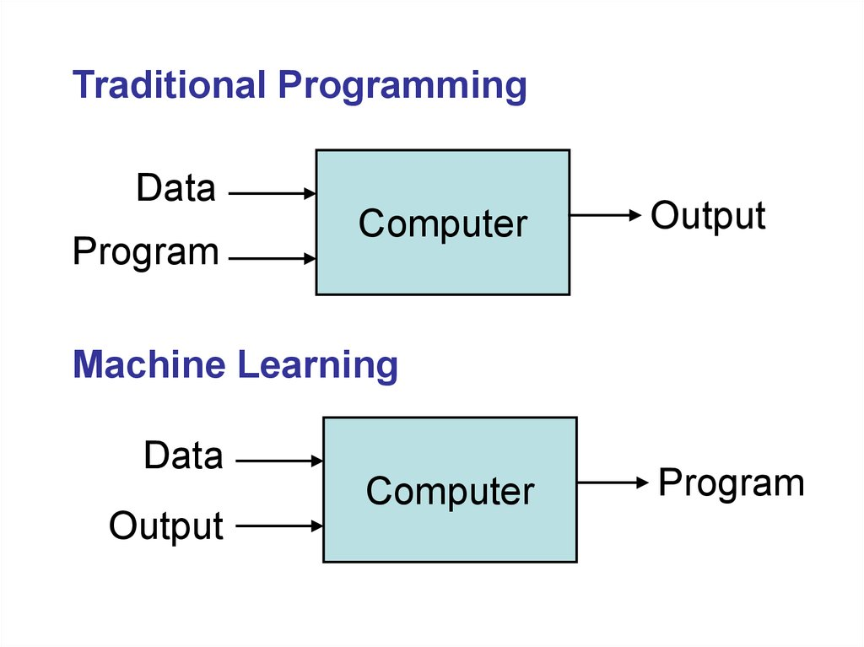
Traditional Algorithm Vs Machine Learning

Slide 2
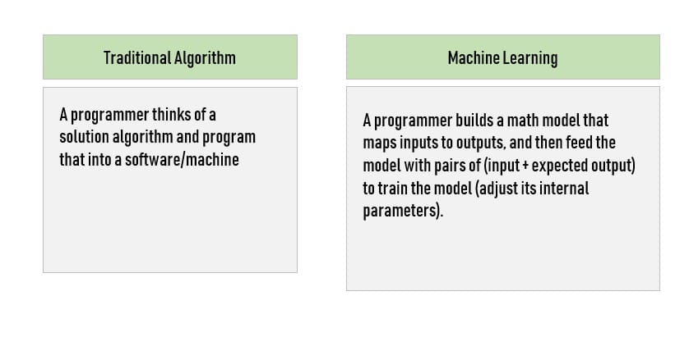

Slide 3
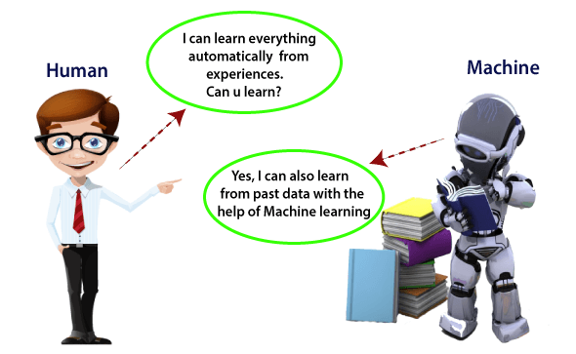
What is Machine Learning
In the real world, humans who can learn everything from their experiences with their learning capability
computers or machines which work on our instructions. But can a machine also learn from experiences or past data like a human does?
Machine Learning is said as a subset of artificial intelligence that is mainly concerned with the development of algorithms which allow a computer to learn from the data and past experiences on their own.
According to Arthur Samuel in 1959 stated that
“it gives computers the ability to learn without being explicitly programmed”.
1997, Tom Mitchell gave a “well-posed” mathematical and relational definition that
“A computer program is said to learn from experience E with respect to some task T and some performance measure P, if its performance on T, as measured by P, improves with experience E.”

Slide 4
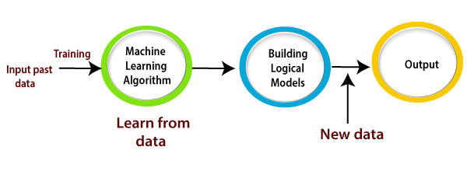
How does Machine Learning work
A Machine Learning system learns from historical data, builds the prediction models, and whenever it receives new data, predicts the output for it.
Suppose we have a complex problem, where we need to perform some predictions, so instead of writing a code for it, we just need to feed the data to generic algorithms, and with the help of these algorithms, machine builds the logic as per the data and predict the output.

Slide 5
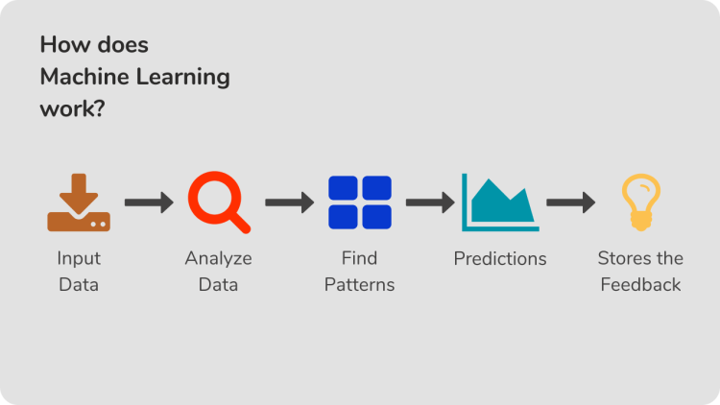

Slide 6
Features of Machine Learning:
Machine learning uses data to detect various patterns in a given dataset.
It can learn from past data and improve automatically.
It is a data-driven technology.
Machine learning is much similar to data mining as it also deals with the huge amount of the data.
The importance of Machine Learning:
Rapid increment in the production of data
Solving complex problems, which are difficult for a human
Decision making in various sector including finance
Finding hidden patterns and extracting useful information from data.

Slide 7
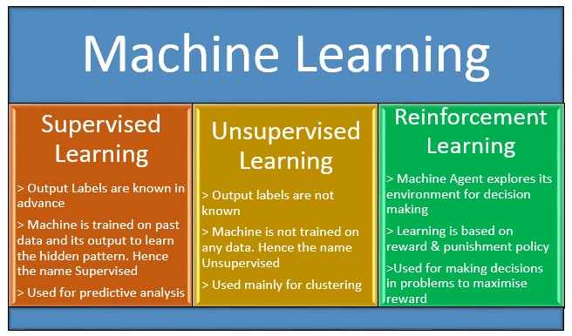
Classification of Machine Learning

Slide 8
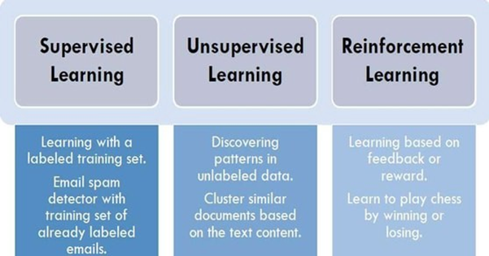

Slide 9
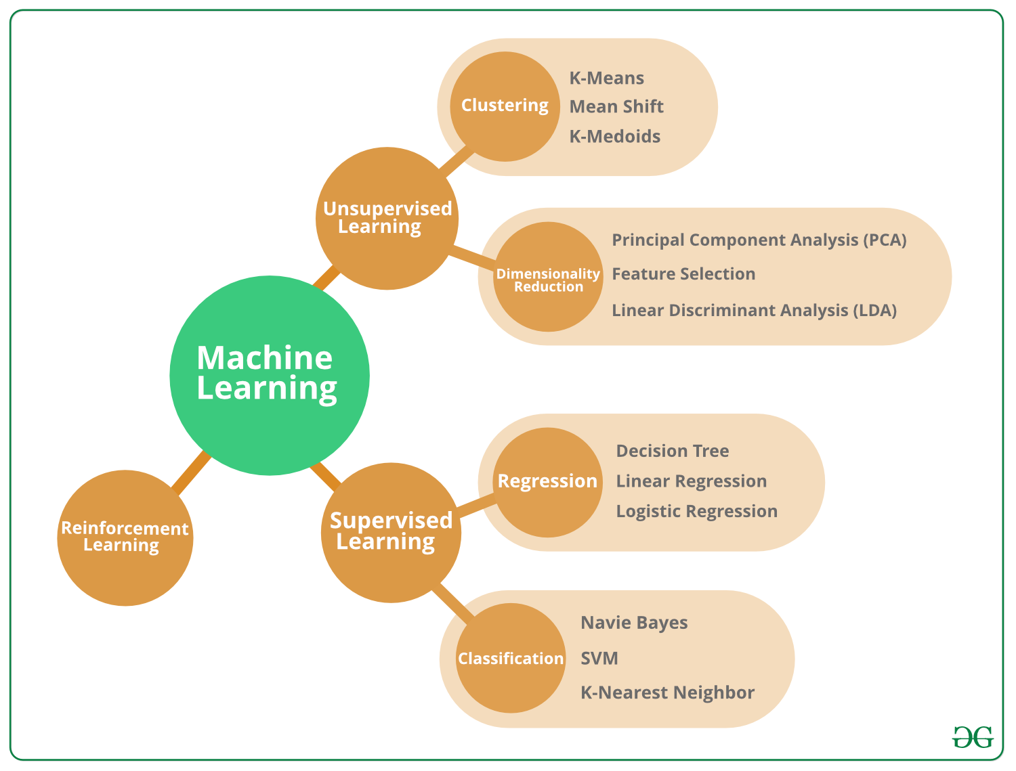
Types of Machine Learning

Slide 10
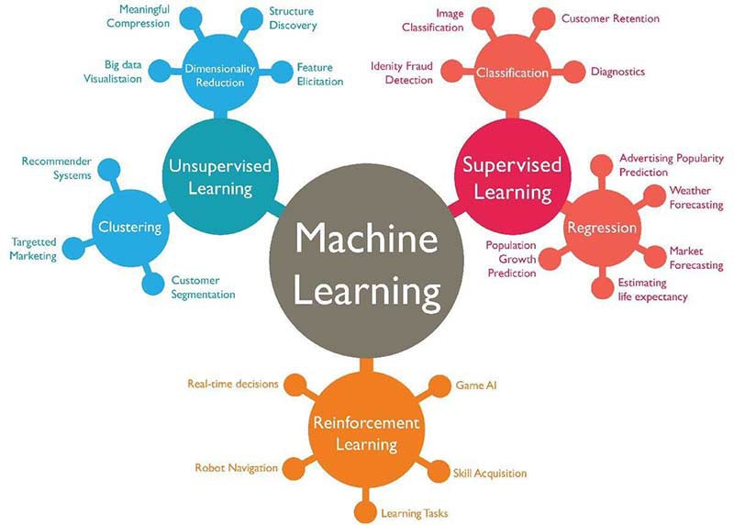
Applications of Machine learning

Slide 11
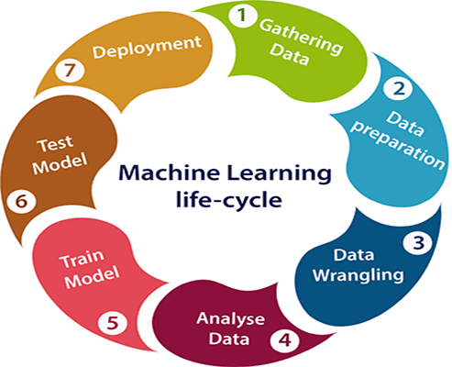
Machine learning Life cycle

Slide 12
Difference between Artificial intelligence and Machine learning
AI: AI is a bigger concept to create intelligent machines that can simulate human thinking capability and behavior, whereas, machine learning is an application or subset of AI that allows machines to learn from data without being programmed explicitly.
ML: Machine learning is a subfield of artificial intelligence, which enables machines to learn from past data or experiences without being explicitly programmed.

Slide 13
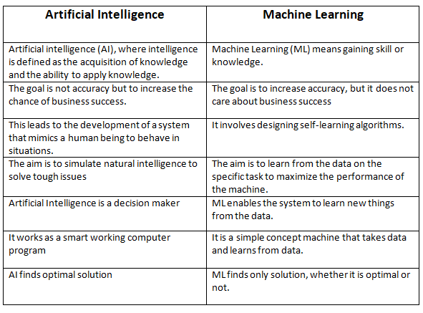
Difference between Artificial intelligence and Machine learning

